Slide 1

Building a Heart Disease Predictor with Logistic Regression
An Internship Project on a Machine Learning Workflow
Author: Prasun Kamilya

Slide 2

Objective & Technical Stack
Project Objective
Core Libraries
To implement an end-to-end machine learning pipeline predicting the 10-year risk of coronary heart disease (CHD) using the comprehensive Framingham dataset.
Data Manipulation: pandas, numpy
Visualisation: matplotlib, seaborn
Machine Learning: scikit-learn for preprocessing, model splitting, and evaluation
This project demonstrates practical application of data science techniques to solve a real-world healthcare challenge.

Slide 3
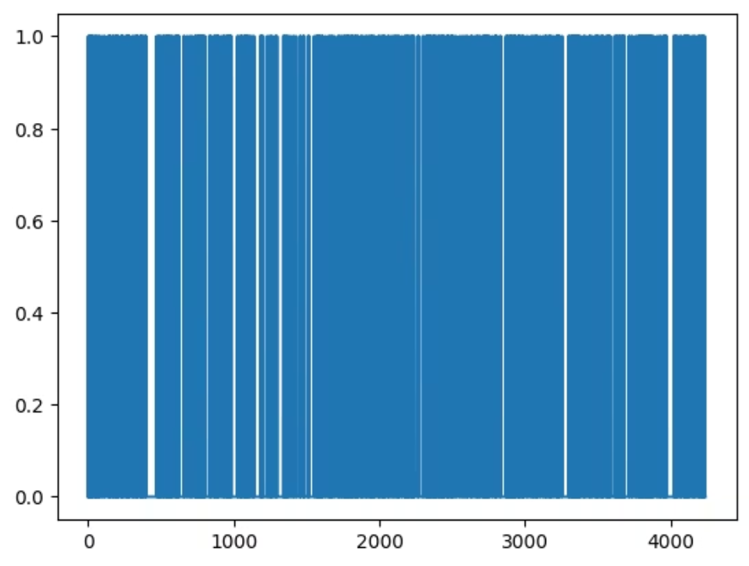
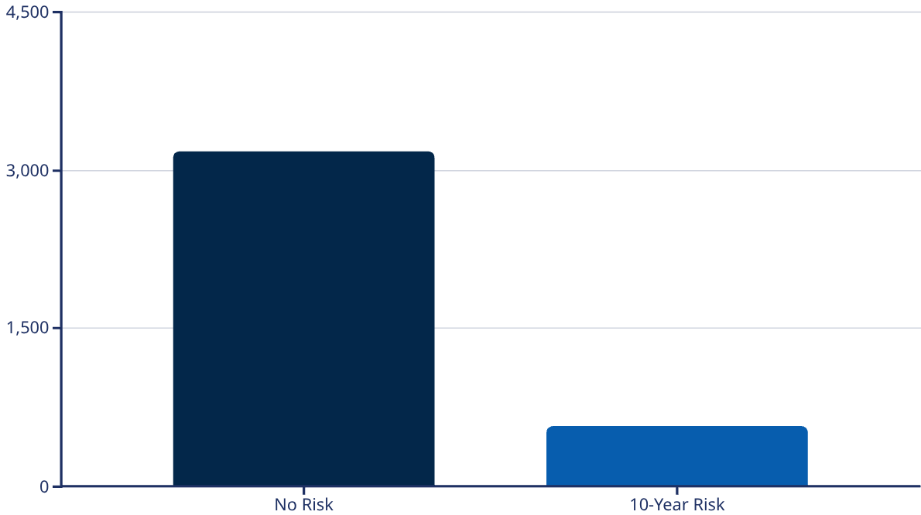
Data Cleaning & Key Insights
01
02
Loading & Cleaning
Handling Missing Values
Loaded the Framingham dataset and removed the 'education' feature due to limited predictive value.
Applied dropna() to remove rows with missing data, resulting in a clean dataset of 3,751 records ready for analysis.
disease_df = pd.read_csv("framingham.csv")disease_df.drop(columns=['education'])
disease_df.dropna(axis=0)
Critical Discovery: Class Imbalance

Slide 4

Preparing Data for the Model
Feature Selection
Target Variable
Selected 6 key clinical features based on medical relevance and predictive potential:
Extracted the 10-year CHD risk indicator as our prediction target.
Age, Sex (male), Cigarettes per day
Total cholesterol, Systolic BP, Glucose
y = np.asarray(disease_df['TenYearCHD'])
X = np.asarray(disease_df[['age', 'Sex_male', 'cigsPerDay', 'totChol', 'sysBP', 'glucose']])
Normalisation
Why this matters: Logistic Regression converges faster and performs more reliably when all features are on a standard, comparable scale.
X = preprocessing.StandardScaler().fit(X).transform(X)

Slide 5



Building the Logistic Regression Model
Data Split
Model Training
Predictions
Divided the dataset into training and testing sets with a 70-30 split.
Initialised and trained the Logistic Regression classifier on the training data.
Generated predictions on the test set to evaluate model performance.
X_train, X_test, y_train, y_test = train_test_split(X, y, test_size=0.3, random_state=4)
from sklearn.linear_model import LogisticRegressionlogreg = LogisticRegression()logreg.fit(X_train, y_train)
y_pred = logreg.predict(X_test)
2,625
1,126
Training Samples
Testing Samples
70% of data used for model learning
30% held back for evaluation

Slide 6



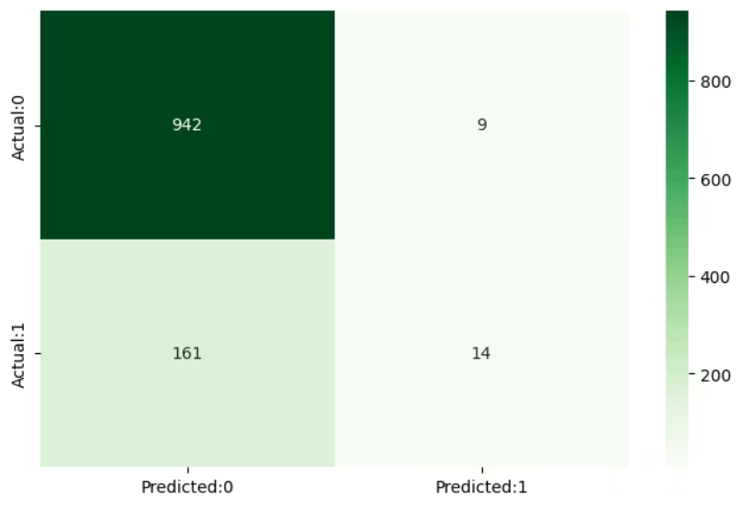

Performance: The Good and The Bad
84.9%
46%
5%
Overall Accuracy
Class 1 Precision
Class 1 Recall
Looks impressive, but accuracy is misleading on imbalanced datasets
When model predicts risk, it's correct less than half the time
Critical problem: Model only identifies 5% of actual at-risk patients
Confusion Matrix Analysis

Slide 7







Key Learnings & Next Steps
Conclusion
Pipeline Success
Accuracy Deception
Successfully built an end-to-end ML pipeline from data cleaning through model evaluation
Learnt that high accuracy can be a misleading metric, especially with imbalanced datasets
Root Cause
Poor performance directly caused by severe class imbalance discovered during EDA
Future Work
Address Imbalance
Implement SMOTE (Synthetic Minority Oversampling Technique) or adjust class_weight parameters to handle the 85:15 ratio more effectively
Explore Alternative Models
Test ensemble methods like Random Forest or Gradient Boosting, which often handle imbalanced datasets more robustly
Deeper Feature Engineering
Investigate interaction terms and additional clinical features to improve predictive signal for minority class

